Slide 1
Classification for Credit Card Fraud Detection
By: Rajshri Totla

Slide 2
ABOUT
Source: Kaggle
Credit Card Transactions by European Cardholders
Fraud detection in banking/finance is major sector
GOAL: Model that can accurately predict fraudulent transaction
Notes:
1. Understand your customers’ behavior
2. Personalize offering based on data results
3. Use trends and patterns to get new customers
4. Benchmark your information against the competition
5. Uncover suspicious activity
6. Reduce chargebacks
7. Determine how to make improvements in the overall business

Slide 3
Tools Used
R for exploratory data analysis to find the most relevant attributes
Weka for building and applying the model
JMP
Python

Slide 4
Dataset Exploration
Numerical 31 Input Variables/Attributes
Result of a PCA transformation
Except Time & Amount features
Highly Imbalanced (492 frauds out of 284,807)
Positive Class – 0.172%
Multivariate Dataset
CLASS: Class Attribute (Fraud: Yes/No)

Slide 5
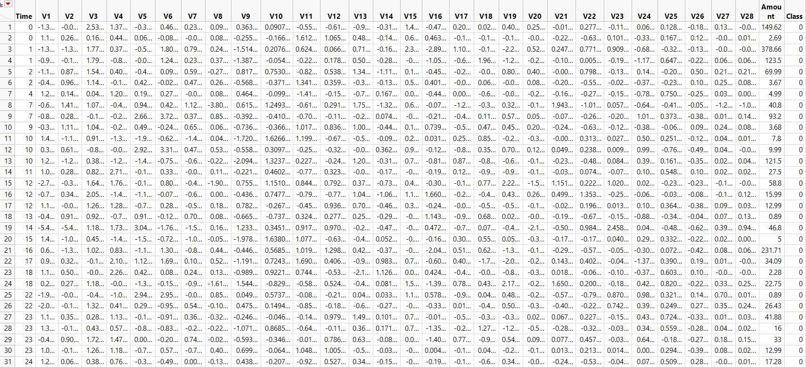
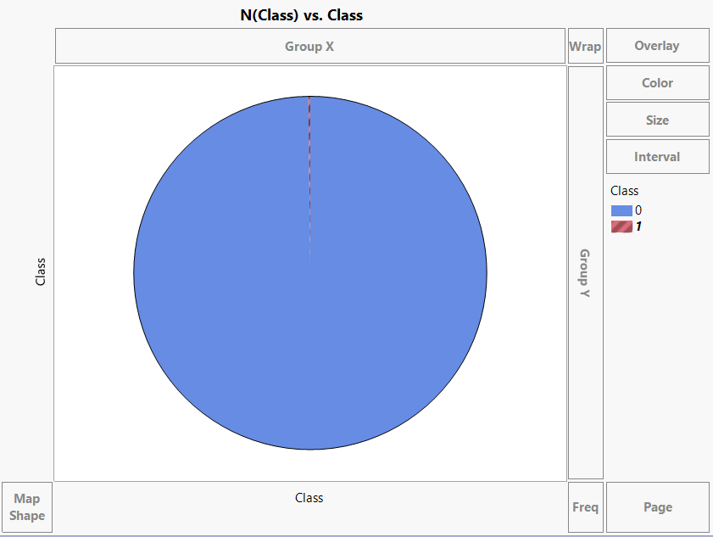
Dataset Snippet
Class Distribution Pie Chart

Slide 6
DATA PRE-PROCESSING
Handling missing and noisy data
Modifying the nominal attribute values
Balancing the class distribution
Under sampling
Drop observations of the majority class
SMOTE (Synthetic Minority Over-sampling Technique)
Duplicate the observations of the minority class
Hybrid Sampling
First uses an under sampling technique to delete some samples of the majority class with less classification information
Then applies an oversampling technique to gradually create some new positive samples
Notes:
By using more than one sampling technique, we can combine the strengths of the individual techniques while lessening the drawbacks.

Slide 7
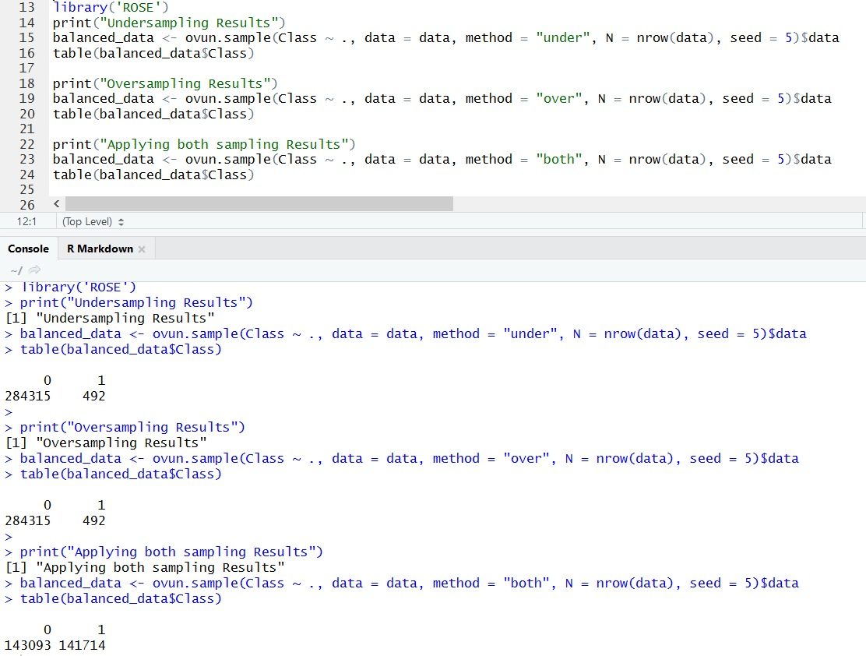
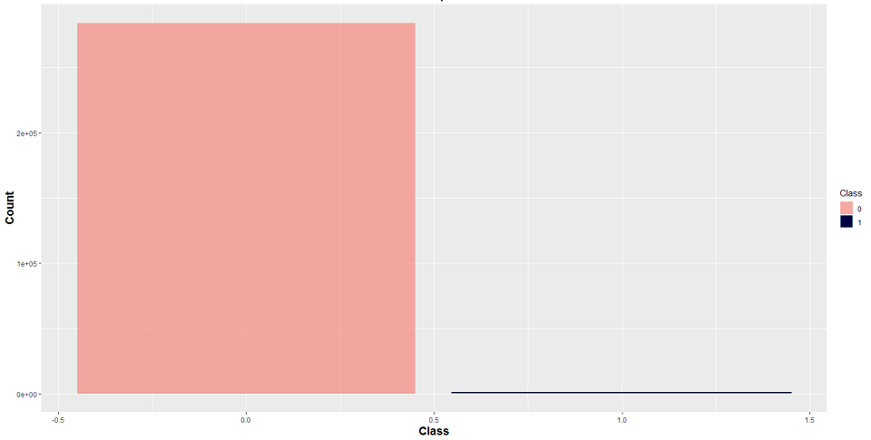
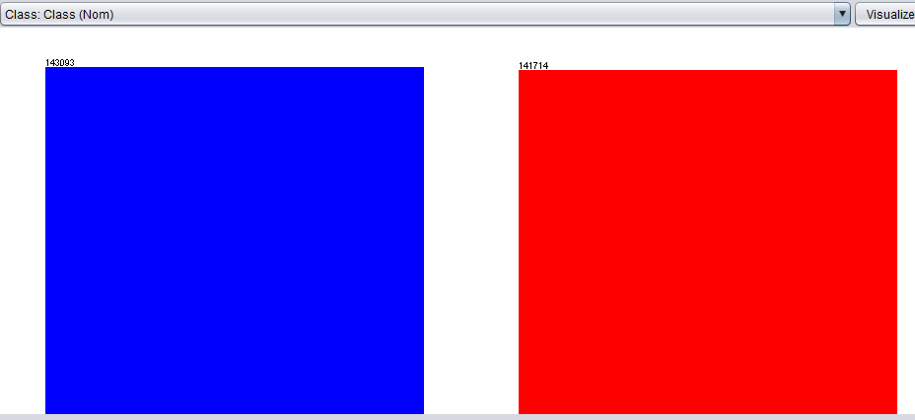
Sampling
R Code
Class | Before Balancing
Class | After Balancing

Slide 8
ATTRIBUTE SELECTION
Correlation
Information Gain
Gain Ratio
One-R
Manual Selection | Python

Slide 9
Correlation | Information Gain | Gain Ratio | One R | Manual Feature Selection
14 | 13 | 17 | 17 | 4
4 | 22 | 14 | 12 | 10
11 | 25 | 12 | 11 | 11
12 | 15 | 10 | 14 | 8
10 | 26 | 11 | 10 | 14
16 | 24 | 4 | 18 | 17
Class | Class | Class | Class | Class

Slide 10
BUIILDING THE MODELS
Simple Logistic
Naïve Bayes
Neural Networks (Multilayer Perceptron)
J48
Random Forest

Slide 11
Simple Logistic
Attribute Selection Algorithm | Accuracy | FP Rate | ROC Curve Area
Information Gain | 55.4961 % | 0.446 | 0.563
Gain Ratio | 93.928 % | 0.061 | 0.979
Correlation | 93.969 % | 0.061 | 0.979
One R | 93.2188 % | 0.068 | 0.964
Manual Selection | 93.9280 % | 0.061 | 0.979

Slide 12
Naïve Bayes
Attribute Selection Algorithm | Accuracy | FP Rate | ROC Curve Area
Information Gain | 59.3057 % | 0.409 | 0.648
Gain Ratio | 92.6453 % | 0.074 | 0.971
Correlation | 92.7097 % | 0.073 | 0.970
One R | 92.0133 % | 0.080 | 0.958
Manual Selection | 92.6453 % | 0.074 | 0.971

Slide 13
Neural Networks (Multilayer Perceptron)
Attribute Selection Algorithm | Accuracy | FP Rate | ROC Curve Area
Information Gain | 64.1499 % | 0.357 | 0.647
Gain Ratio | 95.2986 % | 0.047 | 0.979
Correlation | 95.1944 % | 0.048 | 0.981
One R | 94.2991 % | 0.057 | 0.976
Manual Selection | 95.2986 % | 0.047 | 0.979

Slide 14
J48
Attribute Selection Algorithm | Accuracy | FP Rate | ROC Curve Area
Information Gain | 99.5716 % | 0.996 | 0.997
Gain Ratio | 99.9005 % | 0.001 | 0.999
Correlation | 99.9122 % | 0.001 | 1.000
One R | 99.9181 % | 0.001 | 0.999
Manual Selection | 99.9005 % | 0.001 | 0.999

Slide 15
Random Forest
Attribute Selection Algorithm | Accuracy | FP Rate | ROC Curve Area
Information Gain | 99.9988 % | 0.000 | 1.000
Gain Ratio | 99.9953 % | 0.000 | 1.000
Correlation | 99.9965 % | 0.000 | 1.000
One R | 99.965 % | 0.000 | 1.000
Manual Selection | 99.9943 % | 0.000 | 1.000

Slide 16
RESULTS
Random Forest Classifier
100% accuracy, least average FP Rate and highest area under ROC curve.
Random Forest adds additional randomness to the model,
Instead of searching for the most important feature while splitting a node, it searches for the best feature among a random subset of features
J48 less preferable
Neural Network
Accuracy could be improved using Bagging or Boosting algorithms
Notes:
Random Forest random subset of the features is taken into consideration by the algorithm for splitting a node. You can even make trees more random, by additionally using random thresholds for each feature rather than searching for the best possible thresholds (like a normal decision tree does).

Slide 17
CONCLUSION
Best model to use to detect fraudulent credit card transactions is the Random Forest classifier
Real world banking or finance applications use the Random Forest classifier for learning and predicting consumer behaviour.

Slide 18
Thank you!!!

